Slide 1
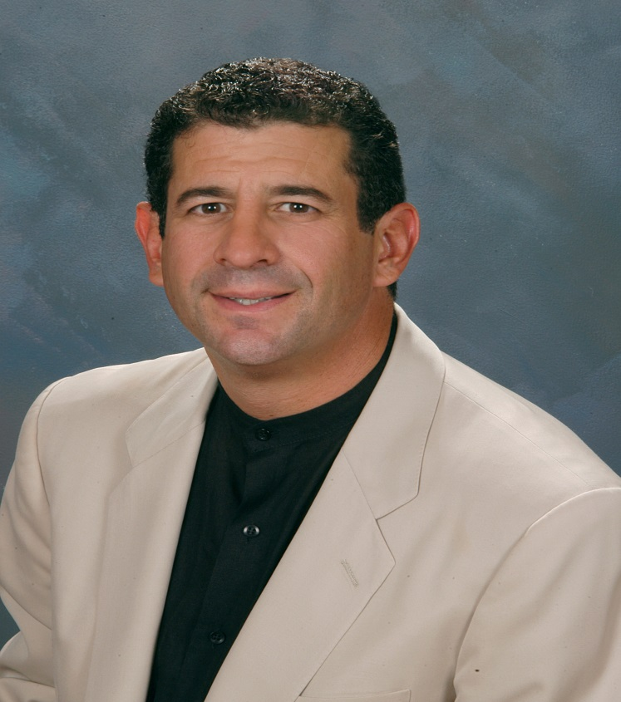
Session 1
Jew and Gentile Ezekiel 47:21-23
Hebraic Interpretation of the Word and the Glory Conference
"Has the true Jesus been hidden from you for 2000 years?. "Are you really understanding the Bible for all it's worth?
You have a rare opportunity to discover the Jewish roots of Christianity, as Jewish Voice Ministries International Staff Evangelist Jack Zimmerman joins us in Series 1 of the Hebraic interpretation of the word and the entering the Glory conference.
Rabbi / Pastor Jack Zimmerman is a Jewish man who came to faith in Jesus in 1988. He holds the unique distinction of being an Ordained Pastor, a Rabbi for Messianic Congregation Tree of Life in Phoenix, and Staff Evangelist for Jewish Voice Ministries International.
A highly effective communicator, Jack was used by the Lord in the secular arena to equip him for work in the ministry: His career began with ABC television in New York, where he served as the stand-up comedian / audience warm-up host for a live TV show. Jack would later host his own television segment, as well as a morning radio co-host in New York and Florida.
An award winning news reporter, Jack interviewed state and world leaders, including the President.
With his background in comedy, he is a dynamic teacher who naturally combines humor as well as great theological depth, in imparting the scriptures. As a Pastor and Rabbi knowledgeable in Hebrew, he understands the Bible from a Roman Greco viewpoint, as well as from its Hebraic origins, and helps his audience to understand and see the transition from one to the other. He has taught Bible classes throughout the United States, as well as at theological universities in Russia and The Ukraine. Jack also is a frequent guest speaker at conferences and events.
Jack holds a degree in Journalism / Radio TV Communications from the City University of New York, and resides in the Phoenix area with his wife Sandie, and their children Jordan, Ryan and Casey. congregrationtreeoflife.com
Rabbi Jack Zimmerman

Slide 2
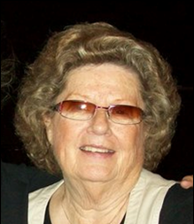
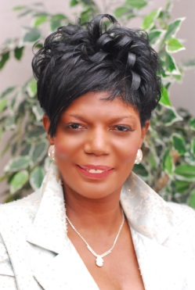
Venue: Tree of Life Congregation
5334 E Thunderbird Rd
Scottsdale , AZ 85254
No fee registration on line or at door www.onekeyministries.org
Rev. Ruth Carneal is a prophetic voice of the hour. She resides in Phoenix, AZ under the leadership of Dr. Michael Maiden. She has ministered in over 75 nations as well as leading mission teams around the world with a focus on blessing Israel. She leads two weekly prophetic prayer services with a special emphasis praying for Israel and our nation through prophetic declaration and the new song. As she ministers you will be challenged to arise above limitations. You will laugh and cry over the testimonies of supernatural encounters and prophetic adventures. Be ready for a life-changing fresh word.
This will be Session 1 of the Hebraic interpretation of Scripture and the Glory series. Your ministry of prayer will draw from these wells of knowledge. Our vision is to offer the attendee exposure to Scripture explained within the realms of Hebrew ancient culture and help empower you for a deeper ministry of prayer and intercession.
Come journey with us this weekend and explore your call to prayer
Dr Velma Clopton spent her earlier years on the ground floor with the David Wilkerson NY street ministry. The prophetic mantle on her life lead to the establishment of the Global Prophetic Ministry, an accredited school of ministry that she serves as Founder and Chief instructor. The couple served over 15 years as Senior Pastors in Detroit. Ministry to women and intercessors training is a passion and she has nurtured many into maturity of their calling. Phoenix is now home, moved here recently by divine direction and speaks at local churches. The school will be accepting students in the near future.
Presented by Ruth Carneal Ministries and One Key Ministries
trumpetglory@aol.com

